Slide 1

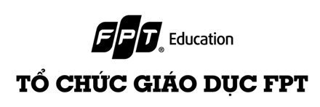
Chapter 1: Web Security Introduction

Slide 2

Key concept
How the web application works
- What is a Web Application?
- Components of a Web Application
- Authentication and Authorization
- Web Communication Basics
Web Application Security
- Fundamentals of Web Application Security
- Common Web Security Vulnerabilities
- Secure Coding Practices
Client-Side vs. Server-Side

Slide 3
Key concept
Web Programming with Python
Security Tools and Scanners
OSWAP and others

Slide 4
1.1 What is a Web Application?
A web application is a software program that is stored on a remote server (or local) and delivered over the Internet (or LAN) through a browser interface. Unlike traditional desktop applications, which are launched by your operating system, web apps must be accessed through a web browser.

Slide 5
1.1 What is a Web Application?
Accessibility: Web applications can be accessed anytime, anywhere, as long as there is an internet connection, unlike desktop applications that are installed on a specific device.
Cross-Platform Compatibility: They work across multiple platforms regardless of the operating system or device, as long as the browser is compatible.
Interactivity: Allows users to interact and manipulate the data. For example, users can enter data, which is then processed and stored, and the output is returned in real-time.

Slide 6
1.1 What is a Web Application?
Widespread Impact: When a web application is accessible across multiple platforms, any security vulnerabilities present in the application potentially impact a broader range of users and devices. A single exploit can affect users on different operating systems, browsers, and devices.

Slide 7
1.2 Key Components of a Web Application
Three primary components of a web application:
The Front-End (Client-Side),
The Back-End (Server-Side),
The Database.

Slide 8
1.3 Understanding Authentication and Authorization
Authentication: Verifying the identity of a user, typically through login credentials. It's the first step in any secure process, ensuring that the user is who they claim to be.
Authorization: Determines what an authenticated user can access and do. It's about granting or denying permissions and access to resources within the application.
Importance: Both are essential for securing web applications, protecting sensitive data, and ensuring that users can only access what they're allowed to.

Slide 9
1.3 Understanding Authentication and Authorization
The Process of Authentication
Methods: Username/password is the most common. Multi-factor authentication adds layers, like a text message code or fingerprint.
Session Management: After a user is authenticated, a session is established. This involves creating a session ID that is stored on the server and in the user's browser, usually in a cookie. This session ID is used to track the user's activities and state across multiple requests, eliminating the need to authenticate for every action.
Example: A user logs into an email service. Post-login, they can navigate through their inbox, send emails, etc., without needing to re-enter credentials, thanks to the session that's been established.

Slide 10
1.3 Understanding Authentication and Authorization
Managing User Access with Authorization
Role-Based Access Control (RBAC): Users are assigned roles (like 'admin', 'editor', 'viewer'), and each role has specific permissions. This simplifies managing user permissions, especially in large applications.
Access Control Lists (ACLs): These are more granular, specifying exact users or groups and what they can access or do within the application.
Example: In a company's internal system, an 'admin' might have complete access to all features, while an 'editor' might only be able to modify content but not change system settings.

Slide 11
1.3 Understanding Authentication and Authorization
Security Vulnerabilities in Authentication
Common Vulnerabilities: Weak passwords can be easily guessed or cracked. Session hijacking involves an attacker stealing a user's session ID to gain unauthorized access.
Best Practices: Enforce strong passwords, use HTTPS to secure data transmission, incorporate mechanisms like captcha to prevent automated login attempts.

Slide 12
1.3 Understanding Authentication and Authorization
Securing Authorization Processes
Least Privilege Principle: Give users only the access they need to perform their tasks. This minimizes potential damage if an account is compromised.
Regular Audits: Periodically reviewing user roles and permissions to ensure they're still appropriate and making adjustments as necessary.
Secure Coding: Avoid security flaws like SQL Injection, which can allow attackers to bypass authorization checks by exploiting vulnerabilities in the application's code.

Slide 13
1.3 Understanding Authentication and Authorization
Tools for Implementing Authentication and Authorization
Authentication Frameworks: OAuth is widely used for allowing users to log in with external accounts (like Google or Facebook). OpenID Connect is built on top of OAuth for more robust identity verification.
Authorization Models: JWT (JSON Web Tokens) are used for securely transmitting information between parties as a JSON object. SAML (Security Assertion Markup Language) is used for exchanging authentication and authorization data between parties, particularly in enterprise settings.

Slide 14
1.4 Web Communication
Fundamentals of Web Communication
Overview: Web communication is the process of exchanging data between a client (usually a web browser) and a server over the internet.
Protocols: The rules and standards (HTTP, HTTPS) that govern how data is exchanged.
Significance: Understanding these basics is crucial for grasping how web applications function and ensuring effective and secure data transmission.

Slide 15
1.4 Web Communication
HTTP and HTTPS: The Backbone of Web Communication
HTTP (Hypertext Transfer Protocol): The foundational protocol for the web, designed for transferring HTML and other web resources.
HTTPS (HTTP Secure): An extension of HTTP, it includes encryption (SSL/TLS) for secure communication.
Encryption in HTTPS: Discuss how HTTPS encrypts data to protect it from eavesdropping and tampering, making it essential for secure transactions like online banking or shopping.

Slide 16
2.1 Fundamentals of Web Application Security
Security's Role: In web programming, security is crucial to protect sensitive data, maintain user trust, and comply with legal standards.
Confidentiality, Integrity, Availability (CIA):
Confidentiality ensures that sensitive information is accessible only to authorized individuals.
Integrity means maintaining the accuracy and consistency of data.
Availability refers to ensuring that information and resources are available to those who need them.
Consequences of Insecurity: Include data breaches, identity theft, financial loss, legal consequences, and damage to reputation.

Slide 17
2.2 Common Web Security Vulnerabilities
SQL Injection: Occurs when attackers manipulate a website's database by inserting or "injecting" malicious SQL statements into a web form or via URL parameters. It can lead to unauthorized access and data breaches.
Cross-Site Scripting (XSS): Attackers inject malicious scripts into web pages that are then viewed by other users. These scripts can steal cookies, session tokens, or other sensitive information from users' browsers.
Cross-Site Request Forgery (CSRF): An attack that forces an end user to execute unwanted actions on a web application in which they are currently authenticated, potentially compromising user data.

Slide 18
2.2 Secure Coding Practices
Input Validation: Ensure all user input is validated for type, length, format, and range. This prevents malicious data from entering and affecting the system.
Parameterized Queries: Use parameterized queries to prevent SQL injection. This means specifying the structure of a SQL query and passing each parameter as a value, not as part of the SQL string.
Error Handling: Implement proper error handling that doesn't expose sensitive information. Provide generic error messages to users and log detailed errors for internal use.

Slide 19
3. Client-Side vs. Server-Side
Client-Side (Front-End):
Refers to the part of a web application that runs on the user's browser.
Main focus: User interface and experience, including layout, design, interactivity, and navigation.
Technologies: HTML, CSS, JavaScript, and front-end frameworks like React, Angular, or Vue.js.

Slide 20
3. Client-Side vs. Server-Side
Server-Side (Back-End):
Involves the web server and database, handling the business logic of web applications.
Main tasks: Data processing, storage, and retrieval; user authentication; server configuration.
Technologies: Server-side languages like PHP, Java, Python, Ruby, .NET, and back-end frameworks like Node.js, Django, Ruby on Rails.

Slide 21
3. Client-Side vs. Server-Side
Client-Side Vulnerabilities
Cross-Site Scripting (XSS): Occurs when an attacker injects malicious scripts into content from a trusted website. This script is then executed in the user's browser, potentially leading to stolen cookies, session tokens, or other sensitive information.
Insecure Direct Object References (IDOR): This occurs when an application provides direct access to objects based on user input. As a result, attackers can bypass authorization and access data, such as database records or files, directly.

Slide 22
3. Client-Side vs. Server-Side
Server-Side Vulnerabilities
SQL Injection: Occurs when an attacker can insert a malicious SQL query as part of the input to a web application, manipulating the application's interaction with the database.
Broken Authentication: Weaknesses in session management and authentication mechanisms can allow attackers to compromise passwords, keys, or session tokens, or exploit other implementation flaws to assume other users' identities.

Slide 23
4. Web Programming with Python
Python's Role in Web Development: Python, known for its simplicity and readability, is widely used in web development for both server-side scripting and back-end development.
Popular Frameworks: Django and Flask, which facilitate rapid development and clean, pragmatic design for web applications.
Ecosystem and Libraries: Python's rich ecosystem, including numerous libraries and tools that support web development, data processing, and integration with databases.

Slide 24
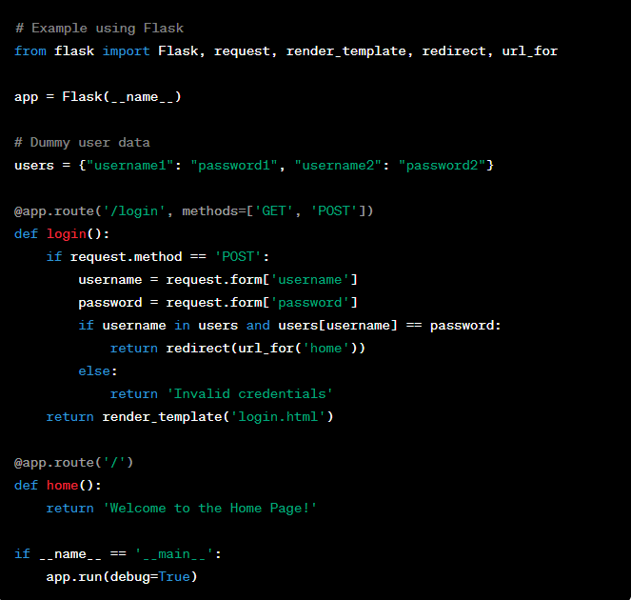
4. Web Programming with Python
Implementing User Authentication in Python

Slide 25
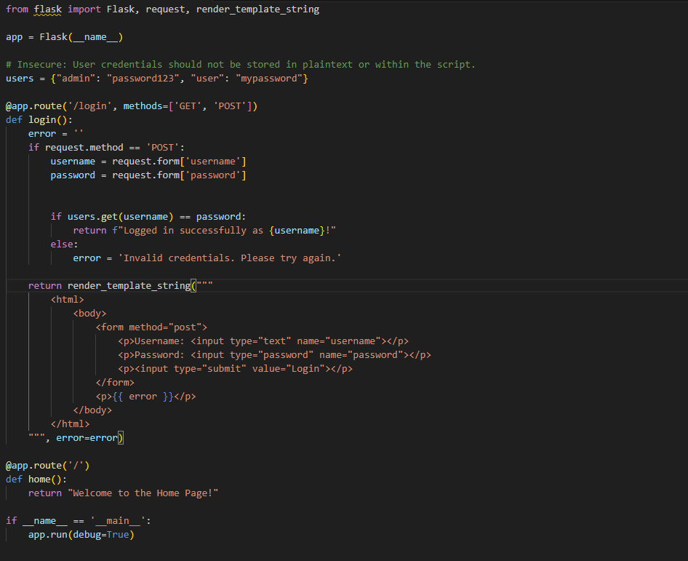
4. Web Programming with Python
Guess the vulnerabilities in this piece of code ?

Slide 26
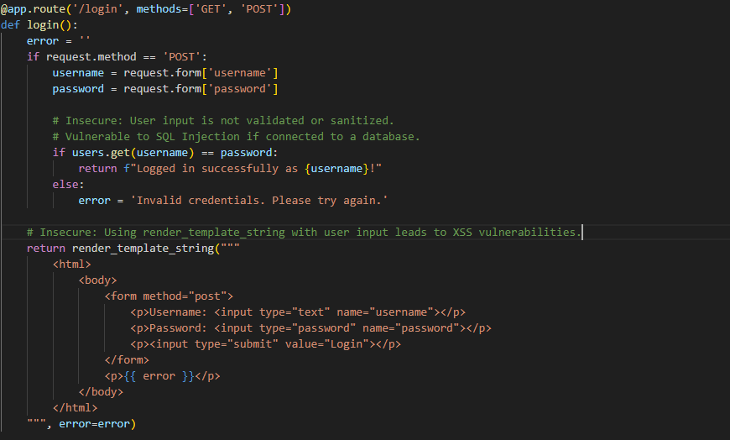
4. Web Programming with Python
Lack of Input Validation and Sanitization:
The user input is not validated or sanitized, making the system vulnerable to SQL Injection attacks if connected to a database.
Cross-Site Scripting (XSS):
Using render_template_string with user-controlled input can lead to XSS vulnerabilities. An attacker could inject malicious scripts that will be executed in the browser of anyone viewing the rendered page.

Slide 27
5. Security Tools and Scanners
Web application security tools are essential for identifying and mitigating vulnerabilities.
Categories include Static Analysis Security Testing (SAST), Dynamic Analysis Security Testing (DAST), and Interactive Application Security Testing (IAST).
These tools are integrated into the software development lifecycle to ensure early and frequent detection of vulnerabilities.

Slide 28
5. Security Tools and Scanners
Static Analysis Security Testing (SAST)
SAST tools analyze source code, byte code, or binary code for security flaws without executing the program.
Examples:
SonarQube: Continuously inspects code quality to detect bugs, vulnerabilities, and code smells.
Fortify: Identifies software security vulnerabilities across multiple programming languages.
Checkmarx: Notable for its fast and accurate vulnerability detection.
SAST tools are beneficial for early vulnerability identification in the development process.

Slide 29
5. Security Tools and Scanners
Dynamic Analysis Security Testing (DAST)
DAST tools assess running applications to find security vulnerabilities.
Examples:
OWASP ZAP: Offers automated scanners for various penetration testing needs.
Burp Suite: Advanced testing and scanning capabilities make it popular among security professionals.
Acunetix: Fast scanning and comprehensive vulnerability detection.
DAST tools are effective for identifying runtime issues, including misconfigurations and authentication flaws.

Slide 30
5. Security Tools and Scanners
Interactive Application Security Testing (IAST)
IAST combines static and dynamic analysis to identify vulnerabilities in real-time.
Notable tools:
Veracode: Provides IAST solutions along with other security testing methods.
Contrast Security: Analyzes code in real-time through instrumentation, offering immediate feedback.
IAST tools stand out for their high accuracy and capability to detect complex security issues.

Slide 31
6. OWASP
OWASP, the Open Web Application Security Project, is a worldwide not-for-profit charitable organization focused on improving the security of software.
It operates as a community of like-minded professionals, including software developers, security experts, and enthusiasts, who contribute to various open-source projects, documentation, tools, and forums.
OWASP's guiding principle is that all of its materials should be freely accessible and open to anyone interested in improving application security.

Slide 32
6. OWASP
OWASP Top Ten - A Standard Awareness Document
The OWASP Top Ten is a regularly-updated report outlining the ten most critical web application security risks. It's widely considered as one of the most authoritative lists of major risks associated with web security.
For example, the 2021 list includes risks like Broken Access Control, Cryptographic Failures, Injection Flaws, Insecure Design, and Security Misconfiguration.
2023 list includes risk like Broken Object Level Authorization, Broken Authentication, Broken Object Property Level Authorization, Unrestricted Resource Consumption, Broken Function Level Authorization.

Slide 33
6. OWASP
Exploring OWASP Projects and Resources
OWASP hosts a variety of application security tools and resources. Projects like ZAP (Zed Attack Proxy), a highly popular tool for finding vulnerabilities in web applications, are integral to security testing.
WebGoat, another OWASP project, is an intentionally insecure web application designed for educational purposes, helping developers understand web application security.
OWASP also provides comprehensive documentation like the Application Security Verification Standard (ASVS), a framework for securing web applications, and the Testing Guide, offering best practices for security testing.

Slide 34
Summary
Overview of web security concepts and their importance in modern web development.
Understanding the threats and vulnerabilities that web applications face.
Explanation of web application architecture, including client-server models.
Critical aspect of security in web programming, discussing common vulnerabilities, secure coding practices.

Slide 35
Summary
Specific vulnerabilities were highlighted for both client-side (like XSS, CSRF, and Clickjacking) and server-side (such as SQL Injection, Broken Authentication, and Sensitive Data Exposure).
Detailed exploration of common web programming tasks, focusing on Python for examples.
Overview of various security tools and scanners used in web application security.
Comprehensive overview of the Open Web Application Security Project (OWASP) and its contributions to web security.

